Slide 1
CSE455 - Software Testing
Chapter 6

Slide 2
Outline
Test Organization
Testing Strategies
Test Planning, Control and Monitoring
Defect Management
Configuration Management
Relevant Standards and Norms
Conclusion

Slide 3
Independent testing
Testing is needed throughout a software product’s life
To ensure quality, testing should be well-coordinated with development
It is more beneficial and efficient to have separate development and testing teams organized independently

Slide 4
Independent testing cont..
+ Unbiased perspective – Testers see things differently from developers
+ More defects found – Independent view helps catch missed errors
+ Critical thinking – Testers challenge assumptions made in code or specifications
- Poor communication – If teams are too separate, it can hurt collaboration
- Limited knowledge – Testers may not fully understand the product
- Reduced developer responsibility – Developers may rely too much on testers

Slide 5
Models of independent testing
Developer Testing
Independent Testing
Independent Testing Teams
Test Specialists
External Service Providers

Slide 6
Models of independent testing
Developer Testing
Developers test each other’s code (not their own)
Use techniques like buddy or pair testing
Independent Testing
Testers are part of the team but only focus on testing
Team members who are assigned for this role perform all testing activities within the team

Slide 7
Models of independent testing
Independent Testing Teams
Separate teams led by test leaders (test manager)
May include experts from other departments when needed
Test Specialists
Expert in specific aspect of testing (e.g. security, reliability)
Support project with coaching, automation and training
External Service Providers
Outside companies handle some or all testing tasks
Can be insourced (in-house) or outsourced

Slide 8
When to use each testing model
Component Testing
Developers – model 1
Dedicated testers if available – model 2
Integration Testing
If components to be integrated are developed by same team – model 1 or 2
If different teams – model 3, 4, 5
System Testing
Need complete independence from developers – model 3, 4, 5

Slide 9
When to use each testing model
Based on Development model
V-model projects
Ensure strict separation of development and test – model 3-5
Agile projects
Teams work closely – model 1, 2
But model 3-5 can also benefit
Specialists support automation and CI/CD
Model 2, 5 can manage automated tests efficiently
Model 3, 5 scale well for large teams or projects
Model 4, 5 provide test coaching

Slide 10
Testing roles
Efficient, professional testing needs staff with experience in testing, and technical fields
Main roles involved
Test Manager
Tester – often split into test analyst, test administrator,
Multidisciplinary IT Specialists
External Testing Service Providers

Slide 11
Test manager
Responsibilities
Plan and lead all testing activities
Draft test strategies and policies
Build, support, and coach test teams
Align with project/product manager
Plan resources (budget, staff, tools, environment)

Slide 12
Test manager cont..
Project Level Contributions
Create test plans, schedules, and status reports
Oversee test case design, automation and execution
Ensure defect/configuration management
Define and evaluate test metrics
Qualifications
Background in software testing, QA, project and HR management
Formal test management training

Slide 13
Tester
A person performing or supporting testing activities (could be developer, business analyst, domain expert etc.)
Tasks
Review test plans and cases
Prepare test data
Run manual and exploratory tests
Use testing tools and run automated tests
Log results and report defects

Slide 14
Tester cont..
Skills needed
Basic IT knowledge
Domain/application expertise
Familiarity with test tools
Certified Tester qualification
Soft Skills
Teamwork, diplomacy, assertiveness
Creativity, precision, quick learner
Critical thinking and problem solving

Slide 15
Multidisciplinary teams
When testing requires specific technical or domain expertise
Common specialists are database designers, network engineers, industry/domain experts
Managing diverse team is complex and requires strong leadership

Slide 16
External testing service providers
Required when in-house team lacks time, tools or expertise
Fast setup of optimized test environments
Experienced testers with ready-to-use skills
Can fill specific role gaps efficiently
Ideal for specialized or large-scale testing efforts

Slide 17
Test planning
Testing is a complex process that needs detailed planning on both
Strategic level – Long-term goals and directions
Operational level – Execution and day-to-day tasks
Strategic planning is the test manager’s responsibility and starts with aligning the project with
Company’s testing policy or strategy
Project-specific objectives, constraints, risks, and quality requirements

Slide 18
Strategic Test planning tasks
Specify the test object(s)
Define what will be tested (modules, components, systems)
Identify exclusions
Draft the test objectives
Clearly define what you’re testing for
Define criteria per test object and for the overall system
Customize the testing process
Adapt the company process to the project needs
Define test levels and how they integrate with other project activities

Slide 19
Strategic Test planning tasks
Select testing methods and techniques
Choose suitable testing techniques (manual, automated, etc.)
Plan necessary training for tools/techniques
Evaluate test automation options
Specify required infrastructure
Identify required environment and tools
Assess existing resources and what needed to be acquired
Document tool and infrastructure requirements

Slide 20
Strategic Test planning tasks
Define test metrics
Choose metrics to monitor and control the test process
Define how and when to react to results
Specify the reporting system
Define what documents/reports to generate (e.g. test logs, defect reports)
Assign responsibilities for reporting and documentation
Provide templates and tool configurations

Slide 21
Strategic Test planning tasks
Plan costing and testing effort
Estimate total effort and resource needs
Define and secure the budget
Revise cost estimates as needed

Slide 22
Outcome: the testing strategy
The result of strategic planning is the test strategy
It’s documented in the overall test plan
Should include
Justification of chosen method
References to alternative approaches in case of changes
ISO 29119 can be used as a structural reference
A strategy may be
A master test plan (applies broadly)
A level test plan (applies to one test level)
A specialized strategy (e.g. for usability or performance)

Slide 23
Outcome: the testing strategy
Strategic planning involves research, discussion, and negotiation
Must be updated as the project progresses and:
Requirements evolve
Risks are reassessed
New insights are gained from executed tests or pilot feedback
Some measures may be reduced or dropped based on risk analysis
Both strategic and operational test planning are continuous
Test manager must:
Stay critical and flexible
Regularly revise plans as the context changes

Slide 24
Selecting a testing strategy
Choosing a strategy is crucial as it affects how effective and efficient testing process is under project constraints and minimizes the project risks
Two core influence:
Decision making freedom
Available knowledge about the project/product

Slide 25
Selecting a testing strategy (based on decision making freedom)
Preventative Approach
Testers involved from the beginning
Enables proactive design of strategy
Uses design reviews, early test specification, static analysis
It detects issues early which results in lower cost, higher quality
Essential for safety-critical systems

Slide 26
Selecting a testing strategy (based on decision making freedom)
Reactive Approach
Testers involved late in the project
Strategy must adapt to current state
Uses exploratory testing, on-the-fly design and execution
Higher defect density and limited prevention risk

Slide 27
Selecting a testing strategy (based on decision making freedom)
“Start early, Stay involved”
A preventative strategy is always recommended
Cost-benefit analysis proves
Early testing → cost savings
Late testing → costly fixes

Slide 28
Selecting a testing strategy (based on experience)
Analytical Approach
Data driven
Relies on metrics, models, and systematic analysis
Best when accurate data is available

Slide 29
Selecting a testing strategy (based on experience)
Heuristic Approach
Experience based
Uses expert judgements, rules of thumb
Used when:
Data is unavailable
Modeling is too complex
Time/resources are limited

Slide 30
Concrete testing strategies
Real-world strategies often mix analytical, heuristic, preventive, and reactive elements
Common combinations:
Risk based + Exploratory
Cost-driven + Automated reuse

Slide 31
Concrete testing strategies
Cost based testing
Maximize cost efficiency
Prefer simple, broad test instead of in-depth, expensive test cases unless justified
Suitable for projects with tight budget and timelines
Risk based testing
Focus on high risk areas
Analyze project/product risks
Test where implicit or likelihood of failure is highest
Suitable for mission-critical systems

Slide 32
Concrete testing strategies
Model based testing
Use models to guide test creation
Use state machines, fault distribution models, or usage frequency as input
Suitable for complex systems requiring systematic coverage
Standard or process oriented approach
Meet external/internal compliance
Use industry standards (e.g. ISO, IEEE), company policies, legal regulations
Suitable for regulated industries (e.g. finance, healthcare, aviation)

Slide 33
Concrete testing strategies
Directive (consultative) approach
Rely on expert judgement and stakeholder input
Based on advice, instincts or experience of domain experts
Often guided by external stakeholders or consultants
Suitable for new technologies, unknown domains or startups
Methodical approach
Apply structured, predefined test conditions
Use list of common defects, quality attributes, UX/UI or brand standards
Suitable for UX-driven, QA-mandated projects

Slide 34
Concrete testing strategies
Reuse based approach
Leverage existing assets
Use test, scripts, environment from previous projects
Setup testing quickly and programmatically
Suitable for iterative development or product family testing
Checklist based approach
Use prior knowledge to guide testing
Refer to defect lists, know failure modes, risk logs and quality priorities
Suitable for organizations with a strong testing history

Slide 35
Concrete testing strategies
Regression averse approach
Protect existing functionality
Use automated regression suites, old test cases and data
Emphasize test repetition
Suitable for large, evolving codebases with frequent updates

Slide 36
Risk and testing
Risk helps prioritize test objectives, techniques, and test cases
Risk = (Expected Loss) x (Probability of occurrence)
Loss – Consequence and cost of product failure
Probability – Likelihood of failure based on product usage
In risk estimation, precise definition of loss and probability is rare; use estimated values or ranges
Risk types are classified into
Project risks
Product risks

Slide 37
Project risks
Risks that threaten the success or continuation of a project
Categories
1. Supplier issues
Contract breaches, delays, legal issues
2. Organizational issues
Resource shortage, Training failure, Poor communication, Political conflict
3. Process weakness
Inefficient defect/configuration management

Slide 38
Project risks
4. Technical issues
Poor/late requirement changes
Unskilled use of new technologies
Defective interim deliverables
Testing environment delays

Slide 39
product risks
Risks associated with quality and functionality of the deliverable product
Examples:
Software doesn’t work or fulfill its purpose
Missing or faulty features
Poor performance or usability
Architecture lacks scalability
Data quality issues (e.g. from migration)
Product causes physical harm or safety issues

Slide 40
Risk management
Systematic approach by project management to reduce or eliminate risk
Steps:
Risk Analysis – Identify potential risks
Prioritization – Rank based on impact and likelihood
Planning – Define countermeasures
Contingency Planning – Prepare for high impact risks

Slide 41
Testing as a risk reducer
Testing provides insights into real-world issues
Reduces uncertainty and helps discover hidden risks
Helps confirm that corrective actions are effective
Note: Testing cannot prevent project risks (e.g. sick leave) but can mitigate product related consequences

Slide 42
Risk based testing
A proactive testing strategy that combats product risks early
Risk-based approach includes:
Choosing techniques, levels, and types of tests based on risk
Determining extent of testing (test cases, variants)
Prioritizing test cases based on risk analysis
Risk evaluation must consider end-user perspective and usage scenarios, also align with insights from stakeholders
Train inexperienced team members to reduce risk
Test high risk components first; Identify major issues early to avoid delays
Avoid equal testing of critical and non-critical features:
Prevents resource waste
Ensure adequate focus on important areas

Slide 43
Testing effort and cost
Understand how cost impacts test planning and strategy
Testing cost is driven by effort, objectives, and associated risks
Outcome of this process is budget estimation and alignment with test goals
Testing cost should reflect:
Test objectives
Component risk level
For low risk components, extent of testing (number of test cases) can be reduced
For high risk components, more rigorous and costly testing is required

Slide 44
Key factors influencing testing effort
Development process maturity
Change frequency and complexity
Testing process maturity
Time pressure
Company stability
Software quality and testability
Documentation quality
System size and complexity
Application domain complexity

Slide 45
Additional influencing factors
Test infrastructure
Testing tools and environment
Standard processes and techniques
Team and co-workers
Experience with tools, domains, products
Team collaboration and communication
Quality objectives
Regulatory compliance
Testing strategy
Test levels and techniques, scheduling and iterations

Slide 46
Estimating testing effort
Many testing techniques are mutually interdependent, hard to quantify factors
Small projects→ estimate as a whole; large projects → estimate per level/iteration
Rule of thumb: Testing effort = 25-50% of total development effort
Estimation techniques:
Expert based estimation
Task by task breakdown by experienced testers
Tends to be overly optimistic
Metrics based estimation
Based on previous similar projects or key performance metrics
More realistic and data-driven

Slide 47
Cost of testing vs cost of defect
If testing is reduced:
More undetected defects
Higher product risk
Increased total cost per release
If testing is increased a lot:
Risk of higher cost or budget overrun
Rule of thumb: Use risk based testing to put resources on high risk components and reduce testing effort on low risk components
Problem: Reducing testing effort can ship product with the undiscovered defects, which can lead towards indirect cost

Slide 48
Cost of flawed product
Direct cost
Financial losses due to incorrect results
Hardware damage, personal injury
Indirect cost
Customer dissatisfaction
Legal penalties
Brand/image damage

Slide 49
Defect correction cost
Defect correction requires
Analysis and fixing time
Regression testing
Delays in releases
Retraining users
For risk analysis, estimate cost probability and impact
Risk depends on product type, industry, number/severity of defects, number of installations
Defects in early phases causes cascading effects
Late detection requires rework across phases and results in slower delivery

Slide 50
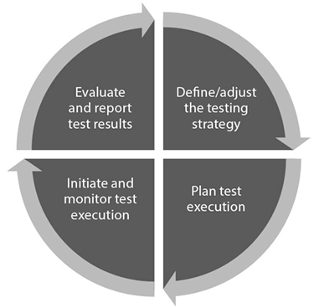
Test management cycle
1. Define the testing strategy
2. Plan test execution
3. Initiate and monitor test execution
4. Evaluate and report test results

Slide 51
Test execution planning
Convert high-level strategy into actionable test cases
Results in a test execution schedule
Must consider current software status, test results, and available resources
Key influencing factors:
Development stage – If features are missing or changed, test plan need updates
Previous test results – New defects results in new confirmation tests
Resources – Limited staff/time/tools may require cutting or prioritizing tests

Slide 52
Test execution planning
Planning the test sequence:
Test execution planning also involves establishing or optimizing the sequence in which the planned tests are to be executed
While sequencing test cases, there must be a balance between test design, test automation, initial execution, regression testing
Run newly created system tests manually first before automating them

Slide 53
Test execution planning
Test prioritization:
When resources are constrained, focus on high-priority test cases
Priority criteria:
Usage frequency – More frequent -> higher chance of failure
Risk level – high risk defects or failures with customer impact
User visibility – Issues easily noticed by user should be tested
Requirement importance – Core features > optional features
Non-functional qualities – performance, security etc.
System architecture – critical or failure prone modules
Complexity – complex code is more error prone
Fix Effect – Components needing major rework should be tested early

Slide 54
Test execution planning
Entry criteria: “Definition of Ready”
Requirements available
Environment, tools, test data and test object are ready
Starting too early increases cost and risk
Exit criteria: “Definition of Done”
All planned tests executed
Required coverage (test/requirement/code) achieved
Target product quality met
Acceptable residual risk threshold not exceeded

Slide 55
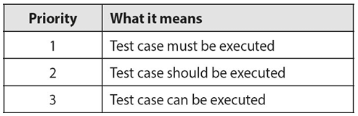
Case study: exit criteria for vsr-ii system testing
The VSR-II test cases are assigned one of three priorities:
Based on these priorities, the test plan lists the following test case-based exit criteria for system testing VSR-II:
All Priority 1 test cases have run without failure
At least 60% of Priority 2 test cases have run without failure
Once these exit criteria are fulfilled, test manager decides whether to deliver the test object.

Slide 56
Test Control
Corrective actions taken to ensure test activities proceed as planned
Supports implementation of test plan and test execution schedule
Initiate planned activities:
Assign test tasks to team members
Ensure timely start and completion of these tasks
Respond to changes or issues:
Quickly reallocate resources (e.g. staff, tools) to address test backlogs
Improvise solutions when necessary, without waiting for next test cycle

Slide 57
Test Control
Evaluate corrective measures:
Check if initiated fixes are effective (e.g. whether an unmet exit criteria how now been met)
Manage deviations:
Address discrepancies from test plan promptly
Plan extra test cycles if critical issues arise – though this may delay release and time to market
Communicate clearly:
Report issues beyond the test team’s control to relevant stakeholders
If test cases are dropped (e.g. due to time constraint), document increased risk and include it in test summary report
Ensure project leaders are informed of any risk-arising issues promptly and clearly

Slide 58
Test Cycle monitoring
Involves gathering data and feedback related to all testing activities to track progress and ensure objectives are being met
Determine whether testing is progressing as planned
Evaluate if exit criteria are fulfilled
Collected information may include product risk coverage, requirement fulfillment, acceptance criteria completion
Data collection can be done manually or automatically
Metrics defined in the test plan are used to:
Monitor testing progress
Check alignment with the test execution schedule and budget
Evaluate the effectiveness of test techniques and strategies
It enables the test manager to make informed decisions and apply corrective actions if necessary

Slide 59
Test Reports
To summarize and communicate the current state of testing to project managers and other stakeholders
Reports are typically created:
At the end of an iteration/test cycle
After completion of a specific testing activity
Interim reports can be issued in response to unexpected issues

Slide 60
Test Reports
Types of Report:
1. Test Progress Report
Focus on the current state of testing in the latest iteration
Brief and iteration specific
Includes test results, progress updates
2. Test Summary Report
Covers all completed test activities across iterations leading up to a release
Used as a basis for product release decisions
Includes a test manager’s evaluation of whether product can be released

Slide 61
Defect management
The process of recording, communicating, managing defects, faults, and issues found during testing
Report creation – starts when a failure or defect is found (e.g. during testing or user report)
Defect logging – each report is structured with consistent information
Assignment – responsibility is defined (e.g. who handles it and when)
Tracking and resolution – monitored until the defect is fixed or closed
Everyone (developer, tester, designer, etc.) must follow the defined process
Create a defect report when a new failure is detected, user reports an issue, a developer finds a fault

Slide 62
Defect management
After each test run, generate a test log that records:
1. Test case/step
2. Expected behavior
3. Actual behavior
4. Any deviation between the two
Helps to evaluate whether a defect exists

Slide 63
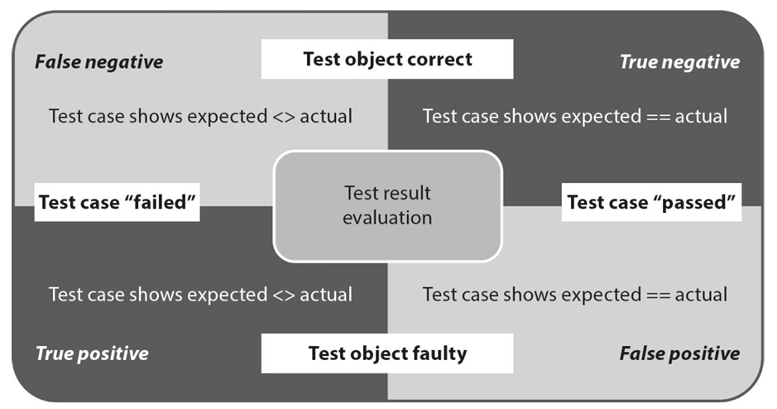
Defect management

Slide 64
Defect management
Description | Classification
Fault exists; test correctly fails (defect found) | True positive
Fault exist; test doesn't catch it (missed defect) | False negative
No fault; test fails wrongly (e.g. bad test case) | False positive
No fault; test passes as expected | True negative
True positive – create or update the defect report
False positive – identify the actual source (e.g. test script, environment)
Duplicate defects – update the existing report with new insights

Slide 65
Defect report
Central part of the defect management process
Logged in a defect database
Covers issues like functional defects, requirement errors, documentation faults
Must be communicated clearly among team members
Do not try to analyze or solve the defect – that’s the developer’s job to which defect report will be forwarded
Report should focus on what happened (effect), where it happened (context), how it affects the systems/user
Defect report must be brief, precise and reproducible (developer should be able to recreate the issue quickly)

Slide 66
Defect report
Use a project-wide standard template
Helps with consistency across other reports
VSR-II reused a proven template from their earlier project which saved a lot of time defining the format for new project
Template should be adapted to:
Project size and complexity
Development life cycle model
Team size and structure
Criticality of the system

Slide 67
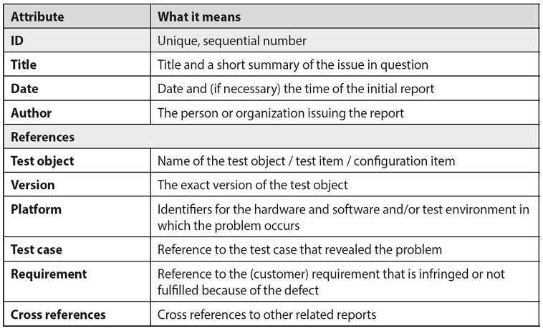
Defect report template

Slide 68
Defect report
Use defect management tools which helps in:
Auto-generating defect numbers
Recording authors automatically
Enforcing the workflow
Allows role based access
Documentation should all necessary information required for:
Fast reproduction of the issue
Easy localization of faults
Tracking process status and metrics

Slide 69
Classifying defect
Helps manage defect correction efficiently
Focuses attention on what most affects the users
Not all issues are equal
System crash → critical
UI misalignment → minor
Severity “How bad is it?”
Measures impact on product use
Example:
Class 1 – critical failure
Class 2 – Major impact
Class 3 – Minor inconvenience

Slide 70
Classifying defect
Priority “How urgent is it?”
Determines order of correction
Based on:
Blocking other tests
Fix effort/time
Release deadlines
Tester ensures that:
Fixes truly resolves the problem
No regression or new issues created

Slide 71
Classifying defect
Status tracking requires end-to-end monitoring of defect analysis and correction process, from discovery and registration to the finished solution
Monitoring is tracked using “status” attribute and rules which determine which changes of status are possible and/or permissible
Different status from which a defect passes according to defect status model:
New – Defects are found by tester and provided title and description in defect report
Open – Test manager assigned the defect to the relevant developer
Rejected – Test manager rejected the defect because it was favoring change in requirements
Analysis – Developer identifies causes of defects, estimation correction effort, and so on
Observation – Developer identify exact part where changes are requires

Slide 72
Classifying defect
Correction – Developer performs the correction; new defects can also result after change
Test – Developer passes the corrected defect to tester for again testing (confirmation testing)
Done – If the confirmation testing performed by tester verified the test (expected = actual)
Flop – If the confirmation testing performed by tester wasn’t successful; further analysis is required
Only testers can set status to “done”
If fix causes new issues →create new defect report
Decision can be made by individuals (small teams) or by committees (large teams)
Change control board (CCB) approves or rejects defect fixes

Slide 73
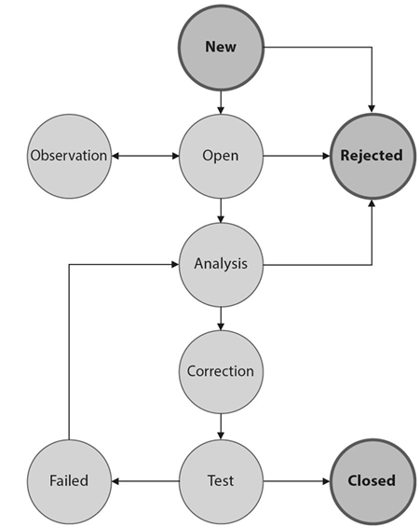
Fig: Defect status model

Slide 74
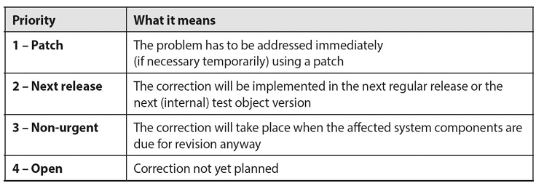
Fault correction priority

Slide 75
Evaluation and reporting
Defect database is used for quality assessment, adapting test plans, release decisions
Key metrics are number of defects, correction status and trends (defect rate is flattening)
Defect trends reveal area needing more tests, weak test coverage, requirement issues
As defect’s trend analysis helps improving existing processes, VSR-II system has extended its exit criteria by adding further three more criteria:
All class 1 defects are “done”
All “patch” priority defects are “done”
Number of “new” defects per week is stagnating or decreasing

Slide 76
Configuration management
To ensure all components of a software system work together correctly, especially in large projects where multiple teams are involved and components exist in different versions
Problem caused by poor CM:
Developers overwrite each other’s work due to unmanaged file access
Integration difficulties from unclear component version compatibility
Defect correction and regression testing become harder due to lack of version traceability
Ambiguity between test results due to unclear test object versions

Slide 77
Configuration management
Requirements for effect CM in testing:
Treat test objects, test cases, and test data as configuration item
Maintain version control with change documentation
Link defect reports to affected configuration items
Conduct configuration audits to validate completeness and correctness of configurations
CM ensures both development/testing and user environment use valid, consistent configuration
CM plans should be project-specific
[IEEE 828] is a standard for configuration management planning

Slide 78
Standards and norms
To ensure software development and testing adhere to recognized quality and regulatory requirements
Sources of standards:
Company standards – Internal guidelines (e.g. quality manuals, coding rules)
Best practices – Proven, non-standardized techniques
Quality management standards – [ISO 9000] focusing on process requirements
Industry specific standards – [EN 60601] for medical devices
Software testing standards – [ISO 29119] most relevant, outlines professional software testing processes

Slide 79
conclusion
Development and testing activities should remain separate with regard to staff and organization. The clearer this distinction, the more effective testing will be
Testing tasks and roles need to be assigned to people with appropriate specialist skills. As well as technical skills, testers should have comprehensive soft skills too
As well as overall strategic test planning, a test manager’s tasks also include operational planning, monitoring, and control for each individual test cycles
The test manager describes the testing strategy (objectives, tasks, tools, and so on) in the test plan
A testing strategy has to strike the best possible compromise between the cost of testing, the available resources, and the potential costs of insufficient testing

Slide 80
conclusion
Tests are prioritized to ensure that less important tests are discarded in the case of a lack of appropriate testing resources
“Risk” is one of the best criteria to use to prioritize tests. Risk-based testing uses information about identified risks to plan and control all aspects of the testing process
Measurable exit criteria provide an objective way to judge when testing is complete. A lack of clear exit criteria increases the risk of testing being terminated randomly
The defect and configuration management processes form the bedrock of an efficient testing process
Defect reports have to be recorded using a unified, project-wide template and must be tracked through all stages of the subsequent analysis and correction processes

